Slide 1
Ethical Control of Unmanned Systems Mission Design and Semantic Web Exemplars for Human Supervision of Lethal/Lifesaving Autonomy
Don Brutzman and Curt Blais, Naval Postgraduate School (NPS)
Unmanned Vehicle and Autonomous Systems (UVAS)
Naval Working Group Meeting
25 March 2020
Notes:
Distribution is unrestricted. See Open-Source License for Ethical Control for details controlling this work.

Slide 2
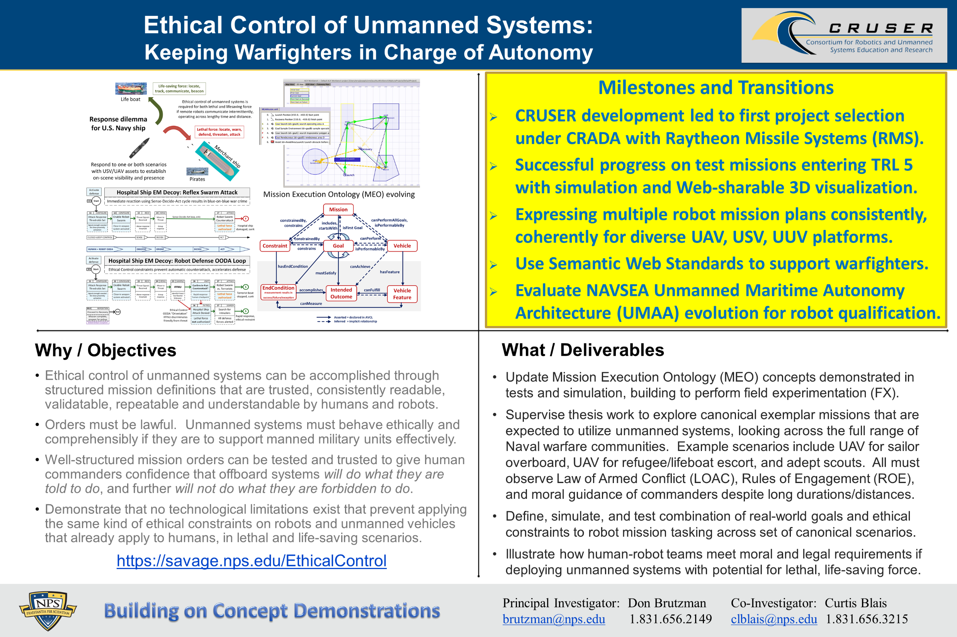
Ethical Control quad chart

Slide 3
Synopsis: Ethical Control of Unmanned Systems
Project Motivation: ethically constrained control of unmanned systems and robot missions by human supervisors and warfighters.
Precept: well-structured mission orders can be syntactically and semantically validated to give human commanders confidence that offboard systems
will do what they are told to do, and further
will not do what they are forbidden to do.
Project Goal: apply Semantic Web ontology to scenario goals and constraints for logical validation that human-approved mission orders for robots are semantically coherent, precise, unambiguous, and without internal contradictions.
Long-term Objective: demonstrate that no technological limitations exist that prevent applying the same kind of ethical constraints on robots and unmanned vehicles that already apply to human beings.
Paraphrase: can qualified robots correctly follow human orders?
https://savage.nps.edu/EthicalControl

Slide 4
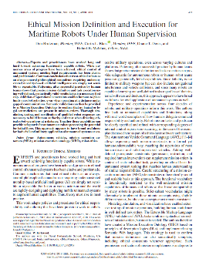
Ethical Mission Definition and Execution for Maritime Robots Under Human Supervision
Theoretical Basis
Don Brutzman, Curtis L. Blais, Duane T. Davis, Robert B. McGhee
IEEE Journal of Oceanic Engineering (JOE), Volume: 43 , Issue: 2 , April 2018
Abstract. Experts and practitioners have worked long and hard toward achieving functionally capable robots. While numerous areas of progress have been achieved, ethical control of unmanned systems meeting legal requirements has been elusive and problematic. Common conclusions that treat ethical robots as an always-amoral philosophical conundrum requiring undemonstrated morality-based artificial intelligence are simply not sensible or repeatable. Patterning after successful practice by human teams shows that precise mission definition and task execution using well-defined, syntactically valid vocabularies is a necessary first step. Addition of operational constraints enables humans to place limits on robot activities, even when operating at a distance under gapped communications. Semantic validation can then be provided by a Mission Execution Ontology to confirm that no logical or legal contradictions are present in mission orders. Thorough simulation, testing, and certification of qualified robot responses are necessary to build human authority and trust when directing ethical robot operations at a distance. Together these capabilities can provide safeguards for autonomous robots possessing the potential for lethal force. This approach appears to have broad usefulness for both civil and military application of unmanned systems at sea.
Notes:
https://ieeexplore.ieee.org/document/8265218

Slide 5
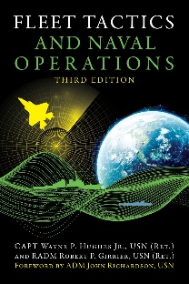
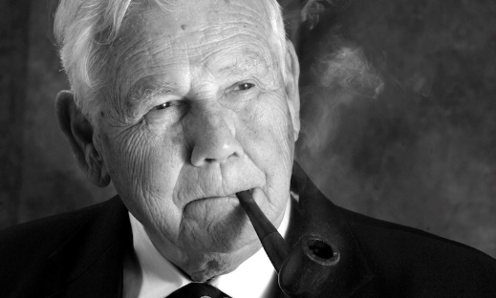
Fleet Tactics and Naval Operations
Wayne P. Hughes, Jr. and Robert P. Girrier, Fleet Tactics and Naval Operations, Third Edition, Naval Institute Press, Annapolis Maryland, June 2018.
https://www.usni.org/press/books/fleet-tactics-and-naval-operations-third-edition
From newly added Chapter 12, A Twenty-First-Century Revolution:
“At the most fundamental level, [Information Warfare] IW is about how to employ and protect the ability to sense, assimilate, decide, communicate, and act – while confounding those same processes that support the adversary.”
“Information Warfare broadly conceived is orthogonal to naval tactics. As a consequence, IW is having major effects on all six processes of naval tactics used in fleet combat – scouting and antiscouting, command-and-control, C2 countermeasures, delivery of fire, and confounding enemy fire.”
“Indeed there is a mounting wave of concern about how far automation will expand and what its impact will be on the continuum of cognition from data to information to knowledge. […] Navies are facing similar uncertainties.”
Wayne Hughes coined the term “Network Optional Warfare” after many discussion sessions, directly contrasting it to Network Centric Warfare. Thank you sir.

Slide 6
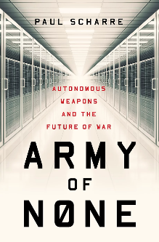
Army of None: Autonomous Weapons and the Future of War
Paul Scharre, Army of None: Autonomous Weapons and the Future of War, W.W. Norton, New York 2018. www.paulscharre.com/army-of-none
“What happens when a Predator drone has as much autonomy as a Google car? Or when a weapon that can hunt its own targets is hacked? Although it sounds like science fiction, the technology already exists to create weapons that can attack targets without human input.”
“Army of None engages military history, global policy, and cutting-edge science to argue that we must embrace technology where it can make war more precise and humane, but without surrendering human judgment. When the choice is life or death, there is no replacement for the human heart.”
Interestingly anticipates many of the approaches taken in this project.

Slide 7
Autonomous Vehicle Command Language (AVCL)
AVCL is a command and control language for humans supervising autonomous unmanned vehicles.
Clarity arises from close correspondence to human naval terminology.
Structured vocabulary defining terms and relationships for mission planning, execution, conduct, recording and replay across diverse robot types.
Common-ground XML representations for
Mission agenda plans, mission scripts, and post-mission recorded telemetry results.
Future work: defining unit tests and expected results for verification and validation.
Operators have single archivable, validatable format for robot tasking, results
directly convertible to and from a wide variety of different robot command languages.
Mission Tasking
https://savage.nps.edu/Savage/AuvWorkbench/AVCL/AVCL.html

Slide 8
Example AVCL mission agenda, as pseudo-code XML
<?xml version="1.0" encoding="UTF-8"?>
<UUVMission>
<GoalSet>
<Goal area=”A” id=”goal1”>
<Search nextOnSuccess=”goal2” nextOnFailure=”goal3”/>
</Goal>
<Goal area=”A” id=”goal2”>
<SampleEnvironment nextOnSuccess=”goal3”
nextOnFailure=”recover”/>
</Goal>
<Goal area=”B” id=”goal3”>
<Search nextOnSuccess=”goal4” nextOnFailure=”goal4”/>
</Goal>
<Goal area=”C” id=”goal4”>
<Rendezvous nextOnSuccess=”recover” nextOnFailure=”recover”/>
</Goal>
<Goal area=”recoveryPosition” id=”recover”>
<Transit nextOnSuccess=”missionComplete” nextOnFailure=”missionAbort”/>
</Goal>
</GoalSet>
</UUVMission>
AVCL is readable by human or robot,
captures logic of mission tasking
XML ensures syntactically correct, well-defined, numerically valid
Needed: semantic representation
to check ethical, logical consistency

Slide 9
Mission clarity for humans – and robots
Simplicity of success, failure, and (rare) exception outcomes encourages well-defined tasks and unambiguous, measurable criteria for continuation.
Confirmable beforehand: can a tactical officer (or commanding officer) review such a mission and then confidently say
“yes I understand and approve this human-robot mission” or, equivalently,
“yes I understand this mission and my team can carry it out themselves.”
Converse:
if an officer can’t fully review/understand/approve such a mission, then likely it is ill-defined and needs further clarification anyway.
Added benefit: missions that are clearly readable/runnable by humans and robots can be further composed and checked by C2 planning tools to test for group operational-space management, avoiding mutual interference, etc.

Slide 10
Wrong question, right question
Wrong question to ask first when planning a tactical operation:
“What are my robots doing out there?”
Right question to ask first when planning a tactical operation:
“What is my human-robot team doing out there?”
Human-robot team mission has to be understood first!
Robots complement humans, who must remain in charge throughout.
If you don’t have an OODA loop, you don’t have a competent plan.

Slide 11
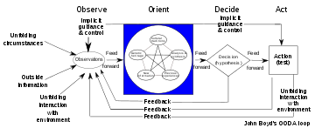
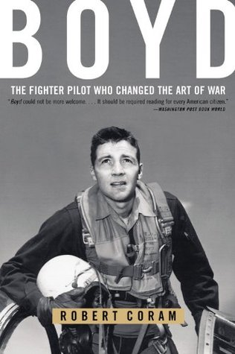
John Boyd and OODA Loop
Wikipedia: John Boyd (military strategist) and Observe Orient Decide Act (OODA) Loop
“… the key to victory is to be able to create situations wherein one can make appropriate decisions more quickly than one's opponent.”
Robert Coram, BOYD: The Fighter Pilot Who Changed the Art of War, 2004.
“John Boyd may be the most remarkable unsung hero in all of American military history. Some remember him as the greatest U.S. fighter pilot ever - the man who, in simulated air-to-air combat, defeated every challenger in less than forty seconds. Some recall him as the father of our country's most legendary fighter aircraft - the F-15 and F-16. Still others think of Boyd as the most influential military theorist since Sun Tzu. They know only half the story.”
“Boyd, more than any other person, saved fighter aviation from the predations of the Strategic Air Command. His manual of fighter tactics changed the way every air force in the world flies and fights. He discovered a physical theory that forever altered the way fighter planes were designed. Later in life, he developed a theory of military strategy that has been adopted throughout the world and even applied to business models for maximizing efficiency. And in one of the stories of modern military history, the Air Force fighter pilot taught the U.S. Marine Corps how to fight war on the ground. His ideas led to America's swift and decisive victory in the Gulf War and foretold the terrorist attacks of September 11, 2001.”

Slide 12
Observe Orient Decide Act (OODA) Loop
“The OODA loop is the cycle observe–orient–decide–act, developed by military strategist and USAF Colonel John Boyd. Boyd applied the concept to the combat operations process, often at the operational level during military campaigns. It is now also often applied to understand commercial operations and learning processes. The approach explains how agility can overcome raw power in dealing with human opponents.” – Wikipedia
All effective purposeful military activity can be conceived in terms of OODA loop feedback process, especially at tactical/operational levels.
Aligning Ethical Control mission design with OODA loop ensures that unmanned systems understandably partner within human-run teams.

Slide 13
OODA Significance for Ethical Control
Classical robotic Sense-Decide-Act cycle for closed-loop control is insufficient for proper delegation of lethal (or lifesaving) force to unmanned systems.
Observe-Orient-Decide-Act (OODA) Loop is essential for coherent operations.
Observe includes direct sensing and communication inputs.
Orientation includes thorough Rules of Engagement (ROE) constraints and identification friend/foe/neutral/unknown (IFFNU) of all relevant contacts.
Decision logic of unmanned system tactics, techniques, procedures (TTP) includes authorization and confirmation by human supervisors, either in real-time or in advance, for critical steps leading to lethal force.
Actions in tandem with direct or intermittent human supervisory command enables effective Ethical Control of remote systems.
Feedback loops are essential, generally leading to… more effective operations.

Slide 14
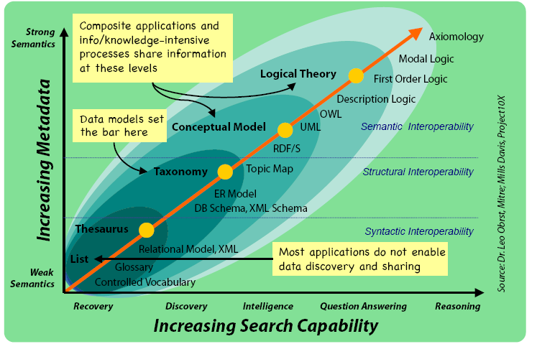
Ontology Spectrum
Improving Semantic Representation

Slide 15
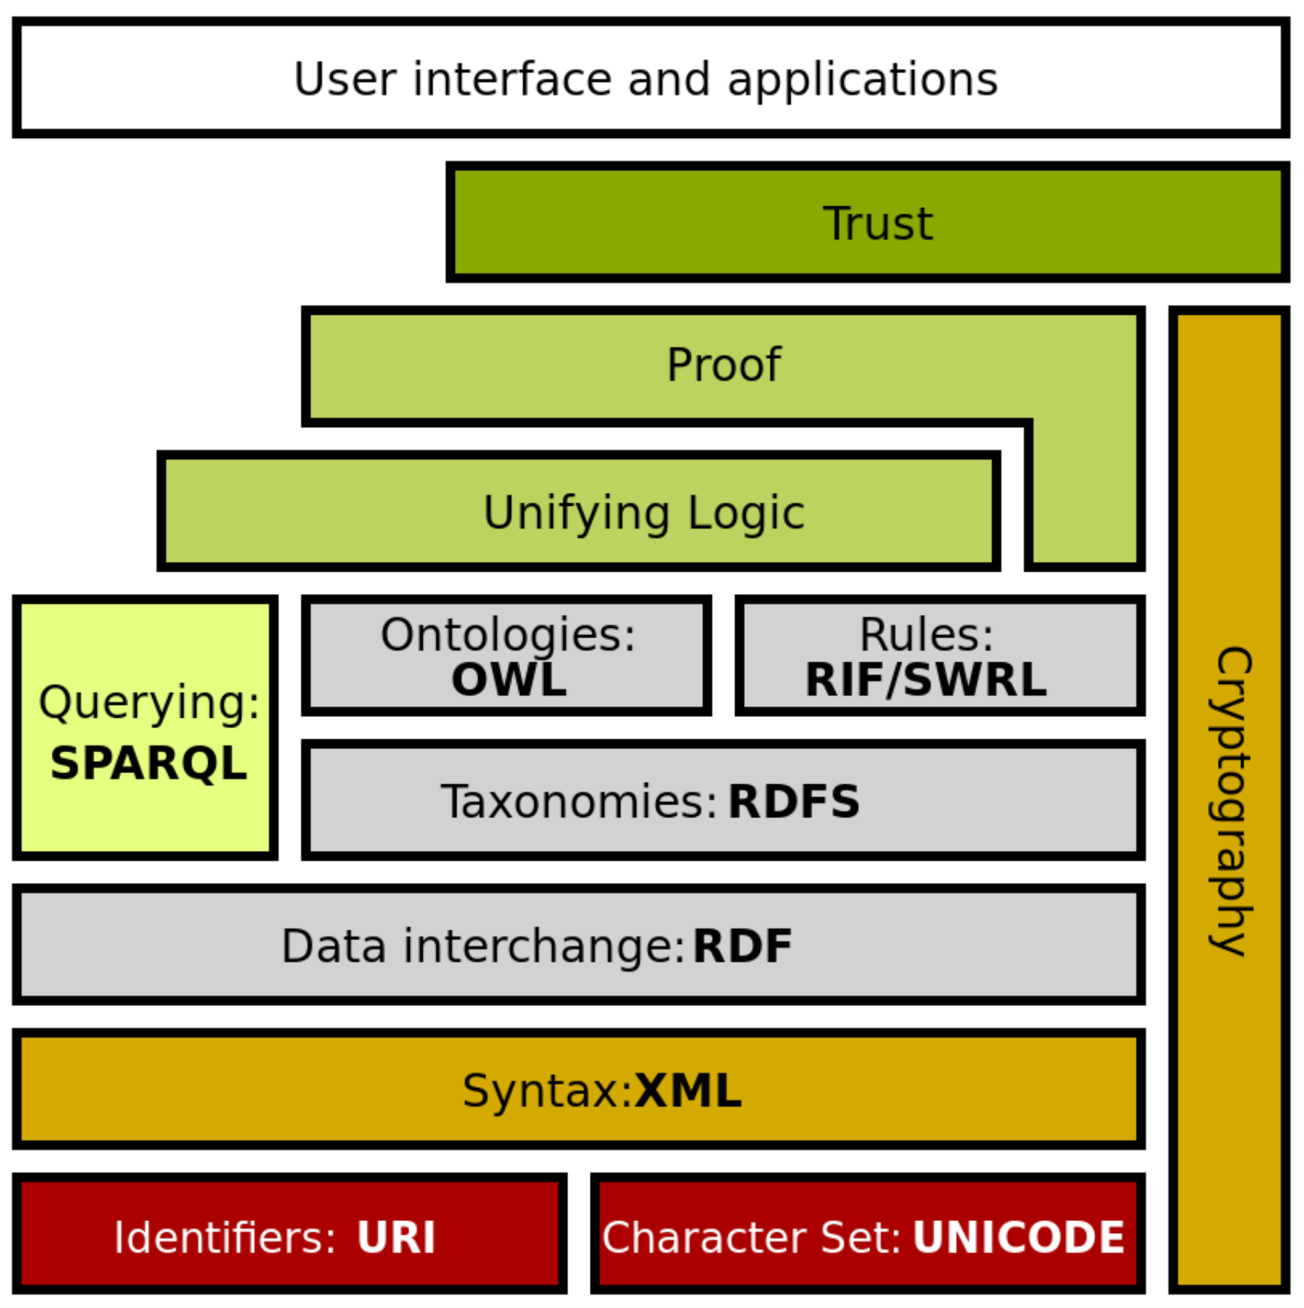
Semantic Web Stack
Extends larger Web architecture
All of these data languages are approved W3C standards
Proof and unifying logic are mathematically well defined
Trusting derived (composed) statements arises from
Encryption + digital signature confirms trusted data sources
Formal logic is basis for deriving new information
Wikipedia: Semantic Web Stack
Of note: this project is exercising every layer of Semantic Web stack.

Slide 16
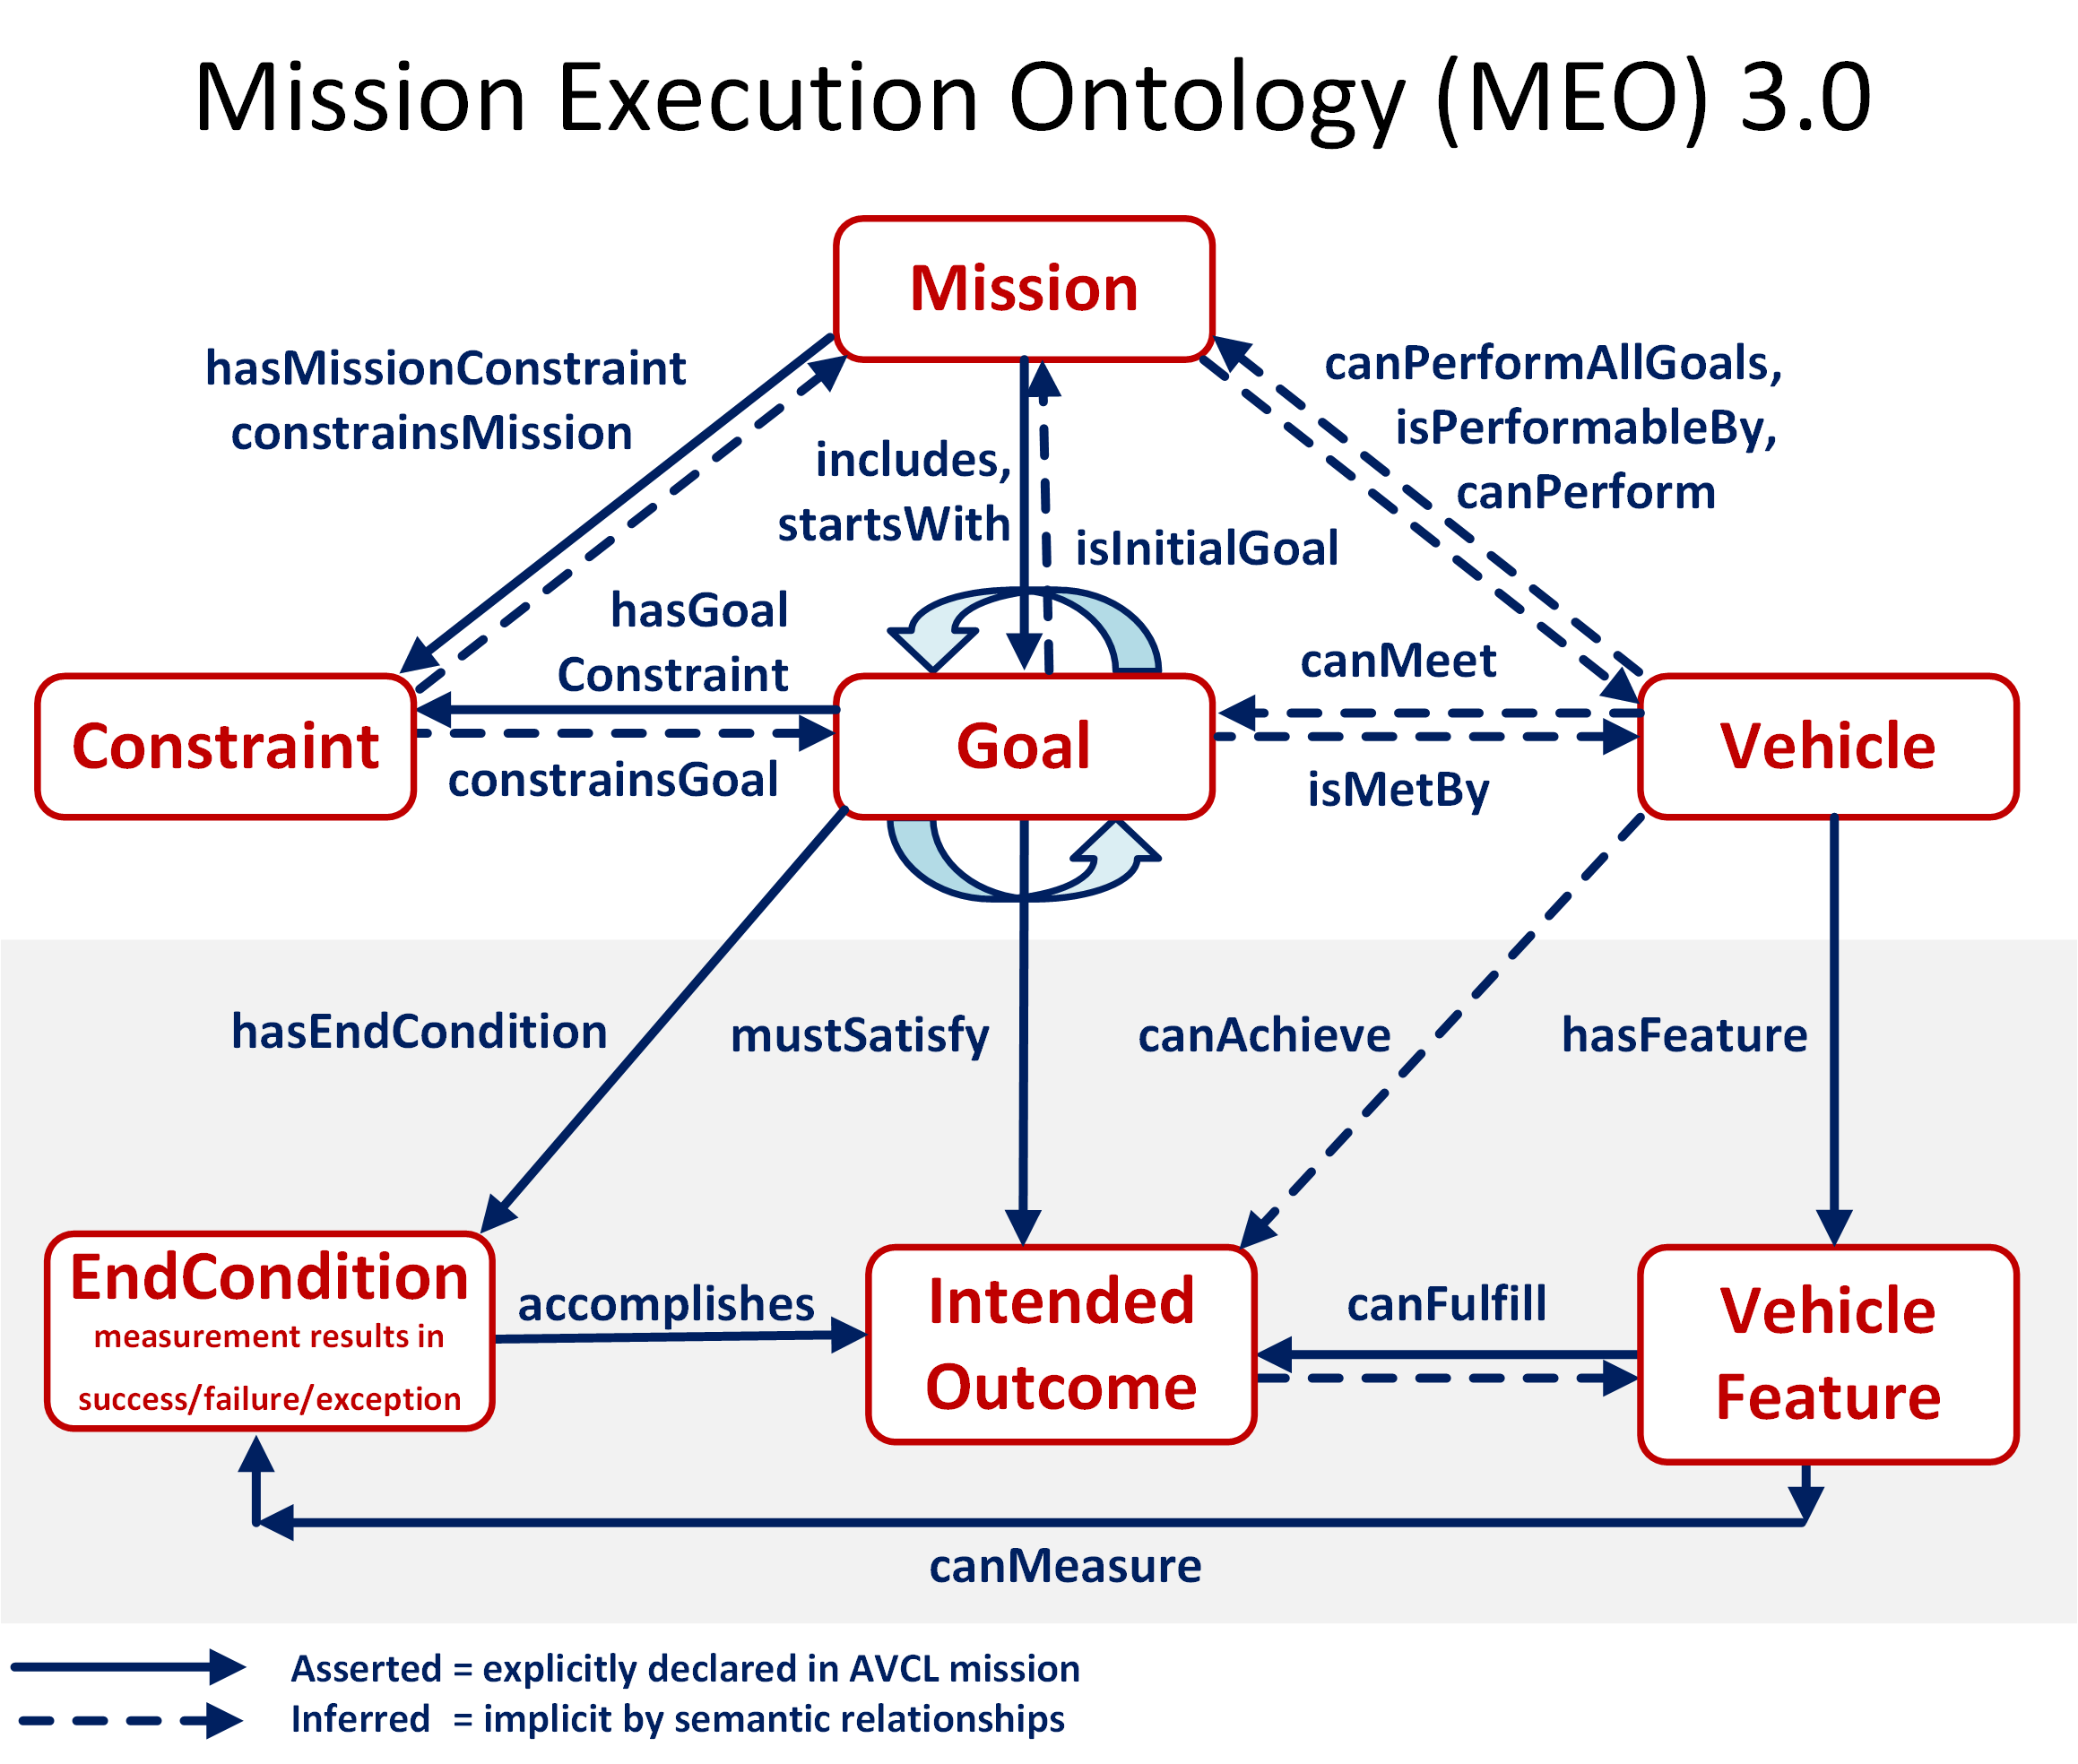

Slide 17
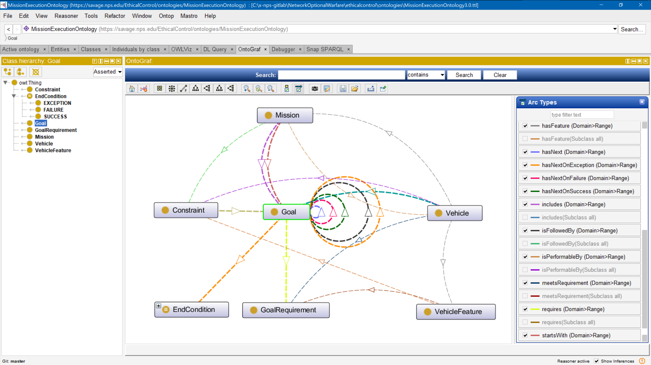
Mission Execution Ontology (MEO) source implemented, tested using Protégé tool

Slide 18
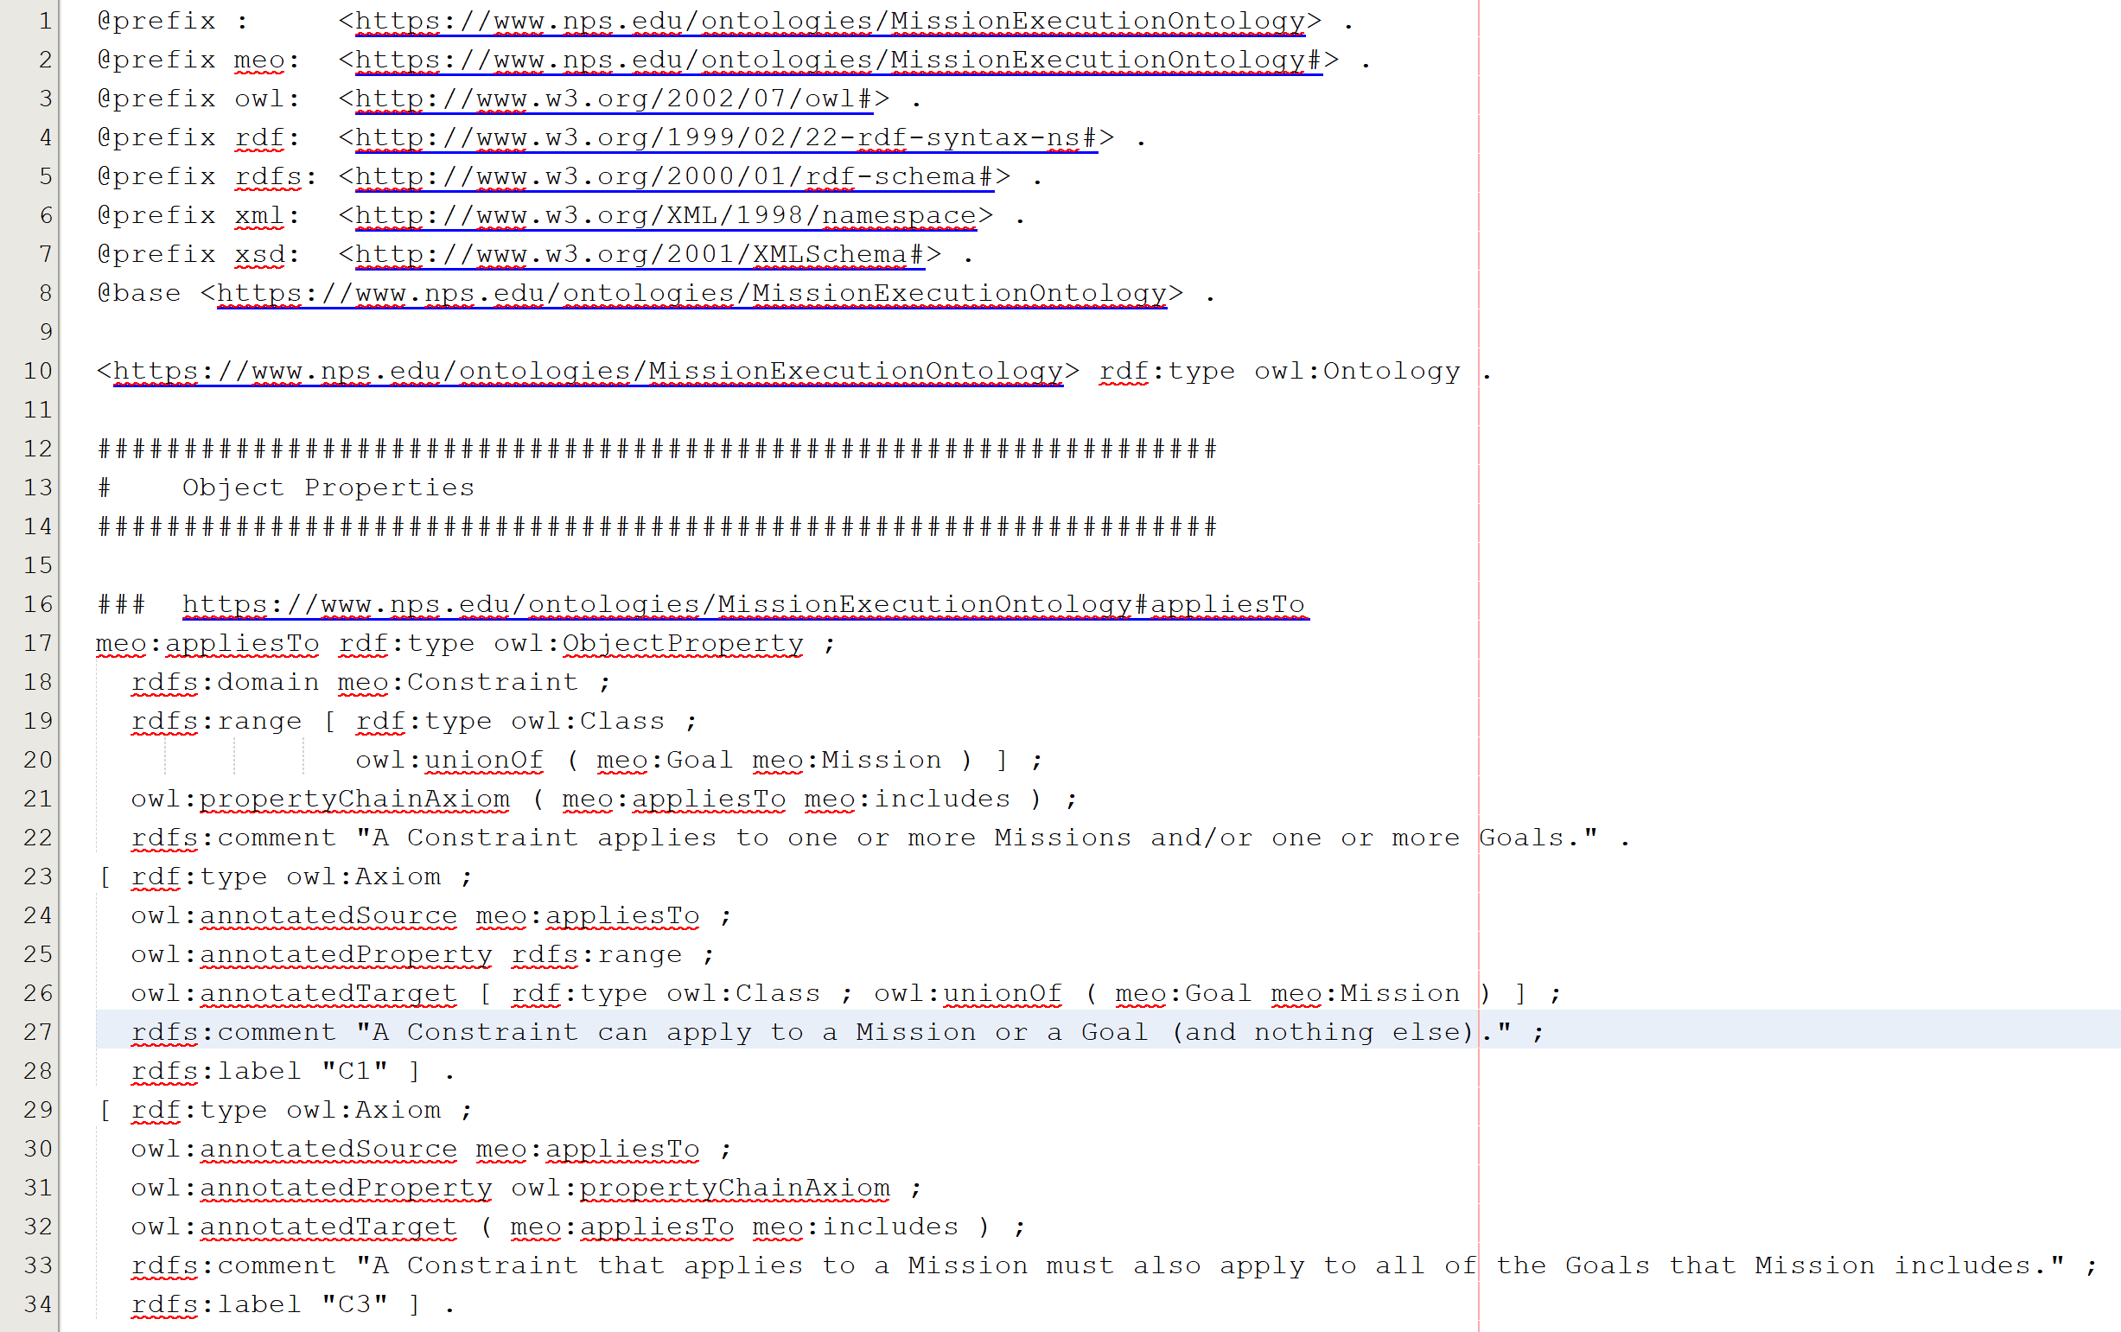
Mission Execution Ontology (MEO) source implemented, tested using Protégé tool
Turtle (.ttl) syntax

Slide 19
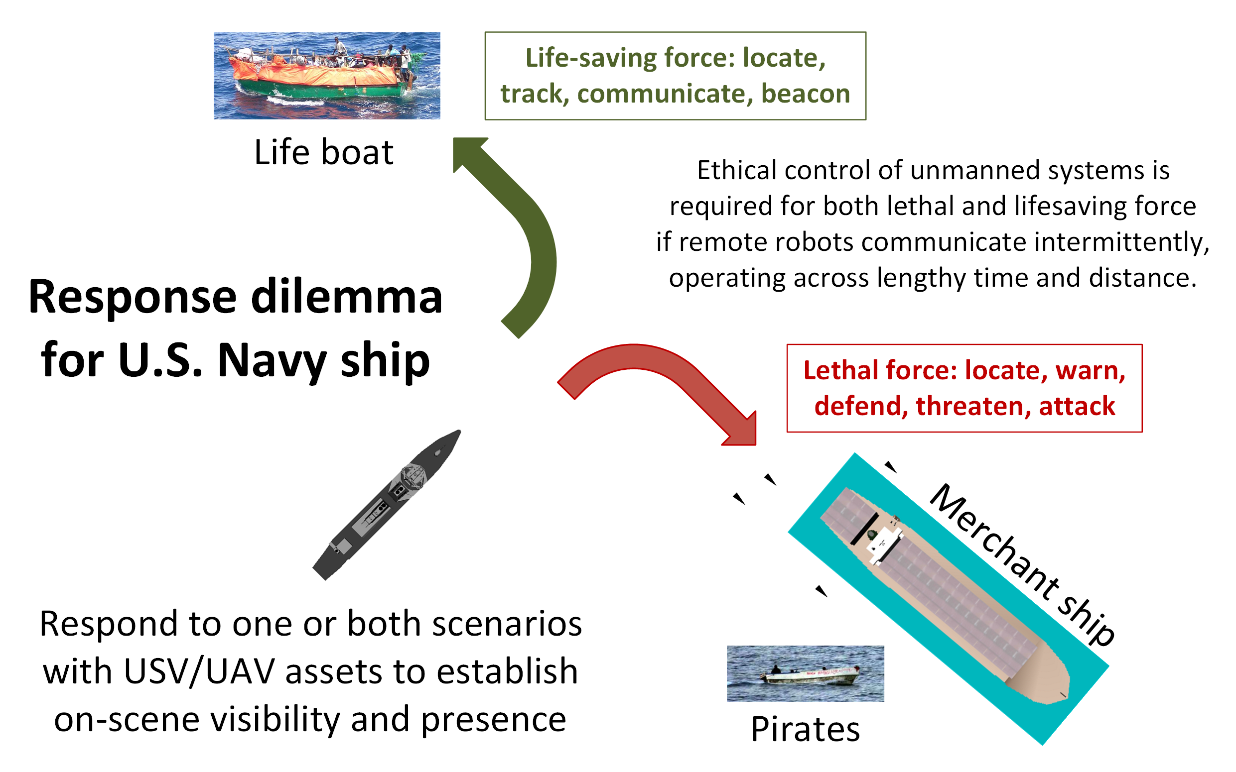
Ship response dilemma

Slide 20
Sailor Overboard Mission: Description
Purpose
Life saving: single unmanned air/surface vehicle actions to complement human responses when performing “SAILOR OVERBOARD” operations.
Carried out in direct concert with formal shipboard emergency procedures.
Multiple UAVs/USVs might be employed in parallel with ships and aircraft, avoid mutual interference by each following deconflicted mission orders.
Phases
Deploy/Launch, Rendezvous, Track Sailor until Safe, Return/Recovery.
Human Supervisory Role
Order standoff if interfering, manual control is possible due to proximity, can communicate to sailor via loudspeaker or beacon light.

Slide 21
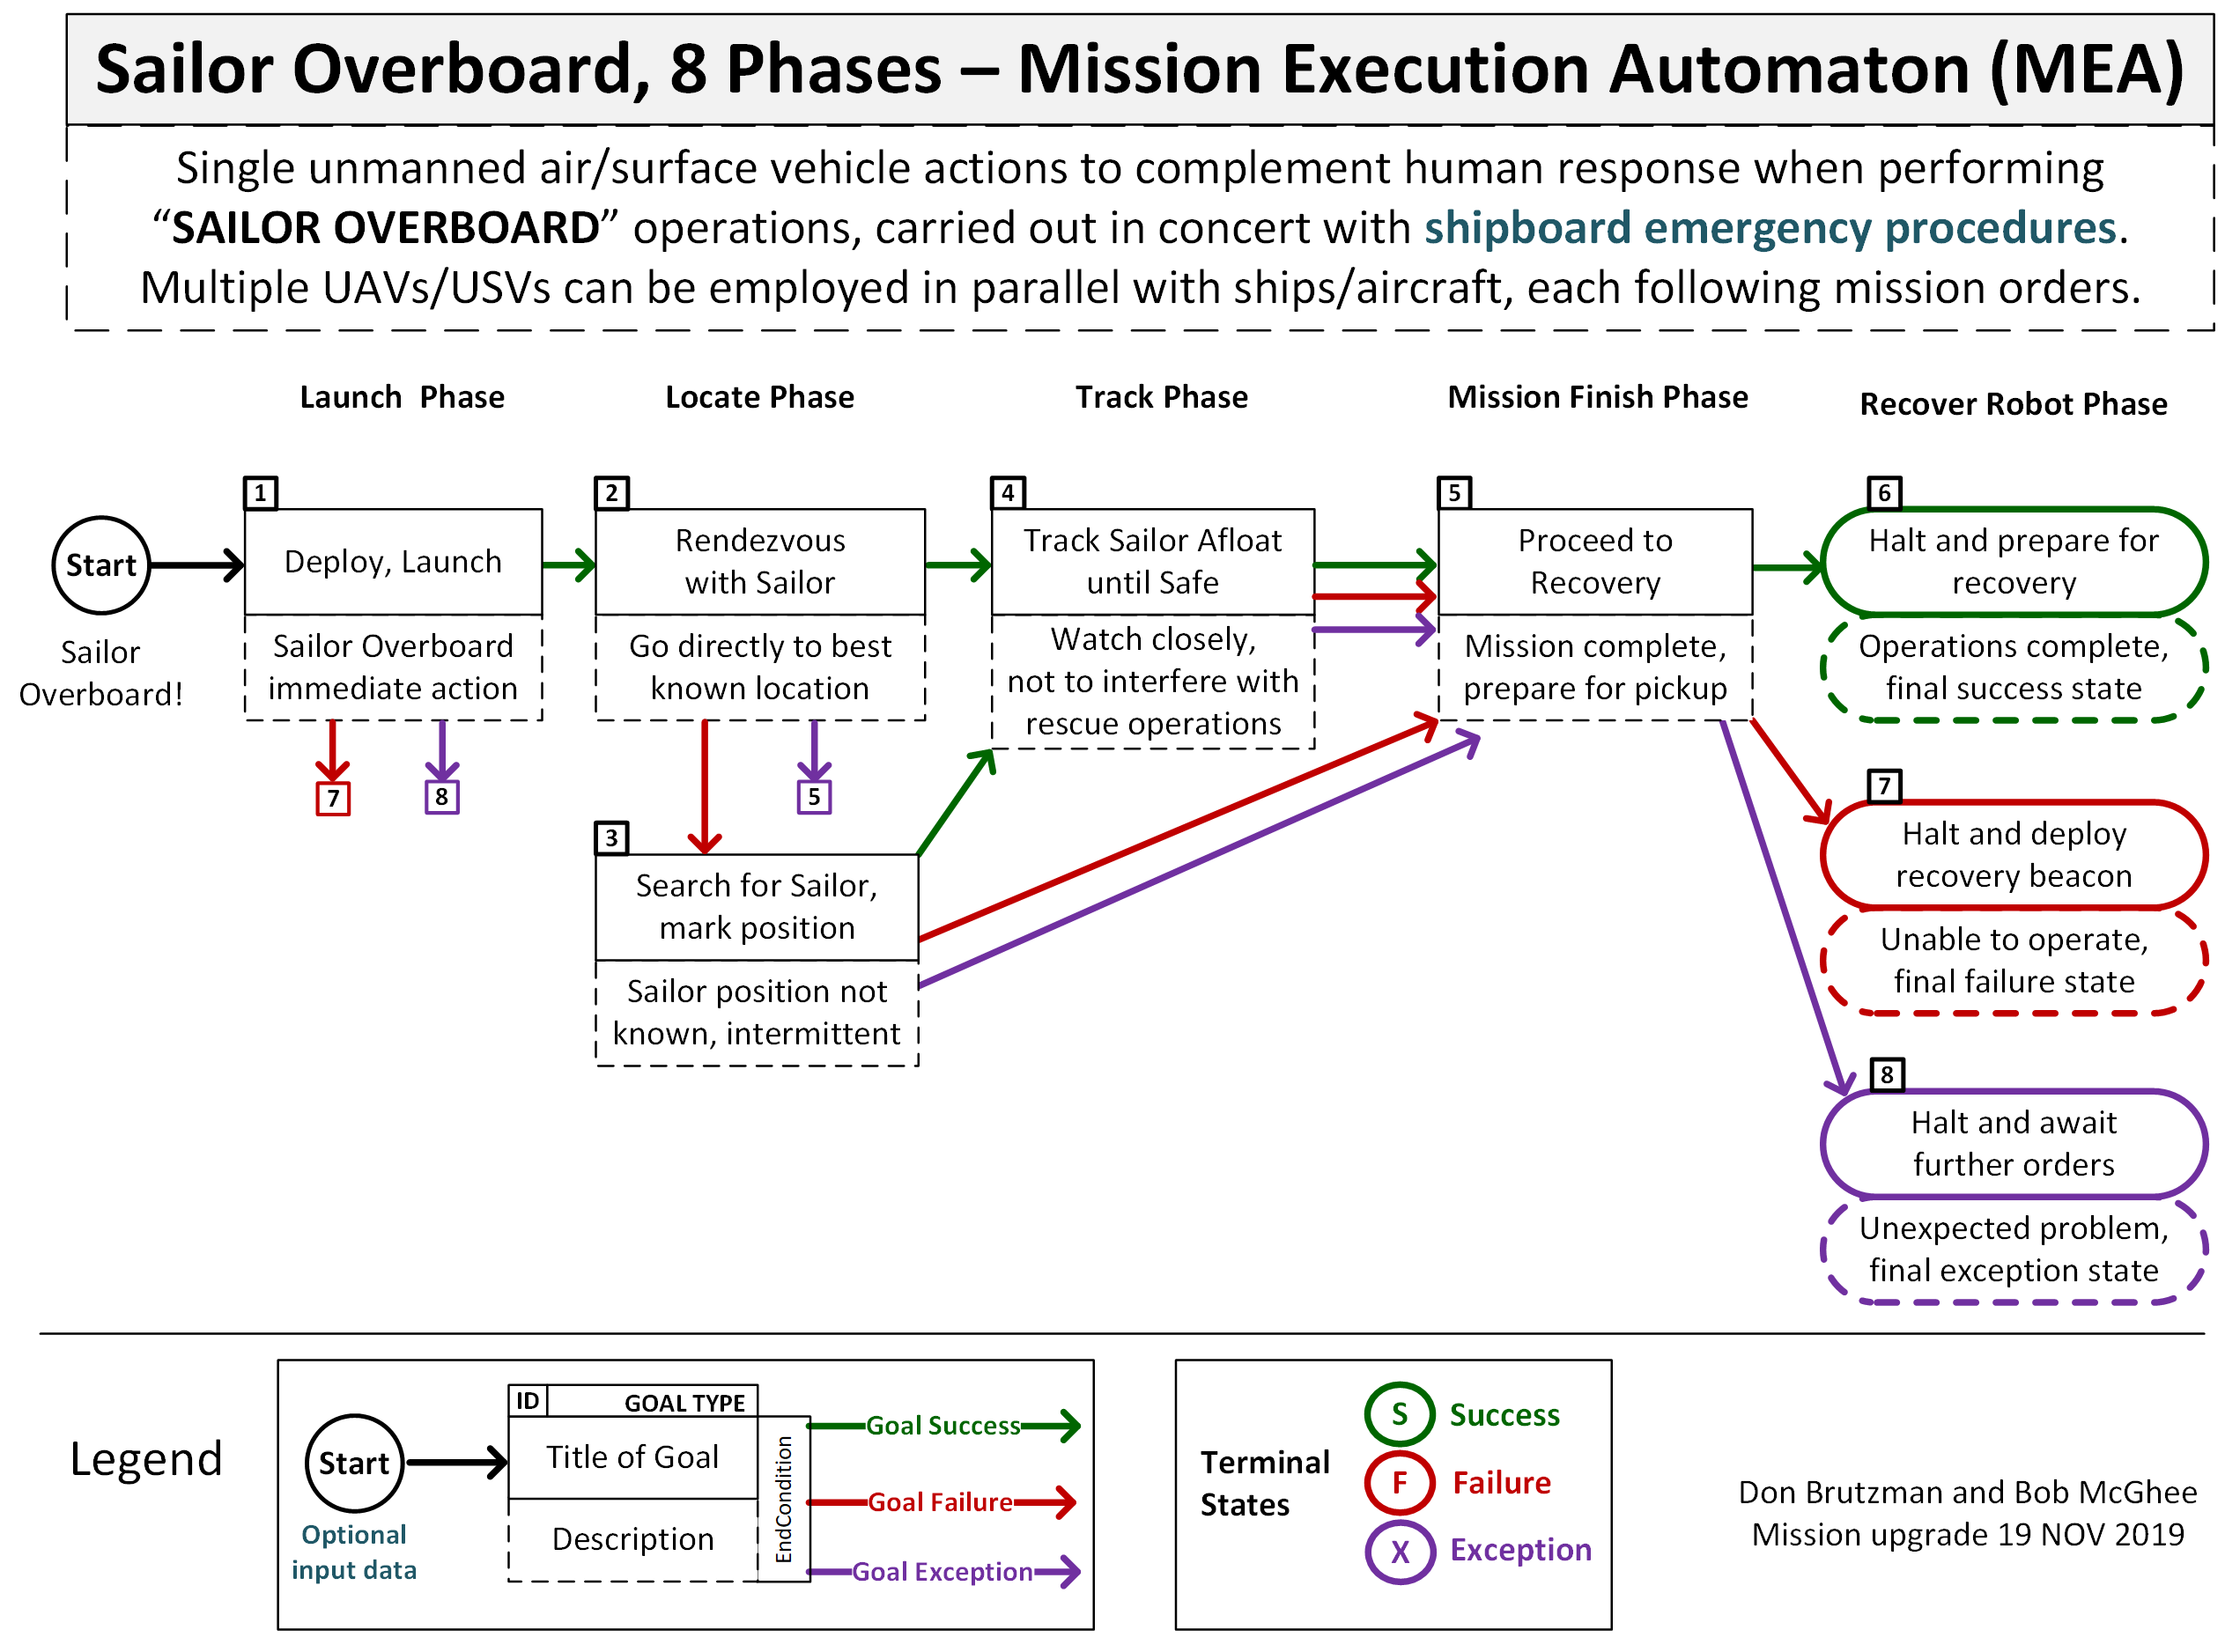
Sailor overboard mission diagram

Slide 22
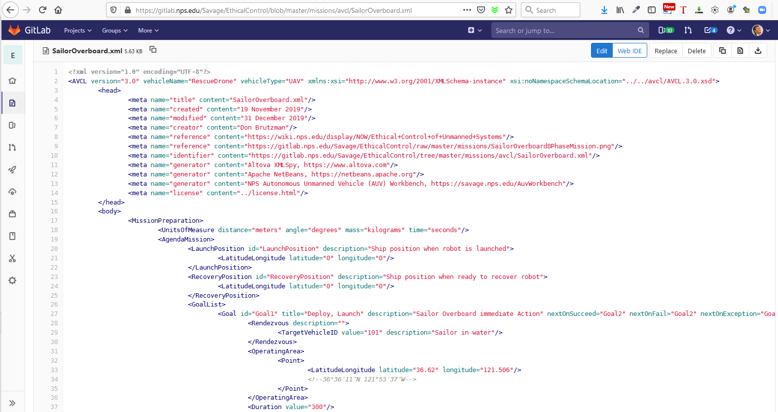
SailorOverboard.xml in gitlab.nps.edu version control

Slide 23
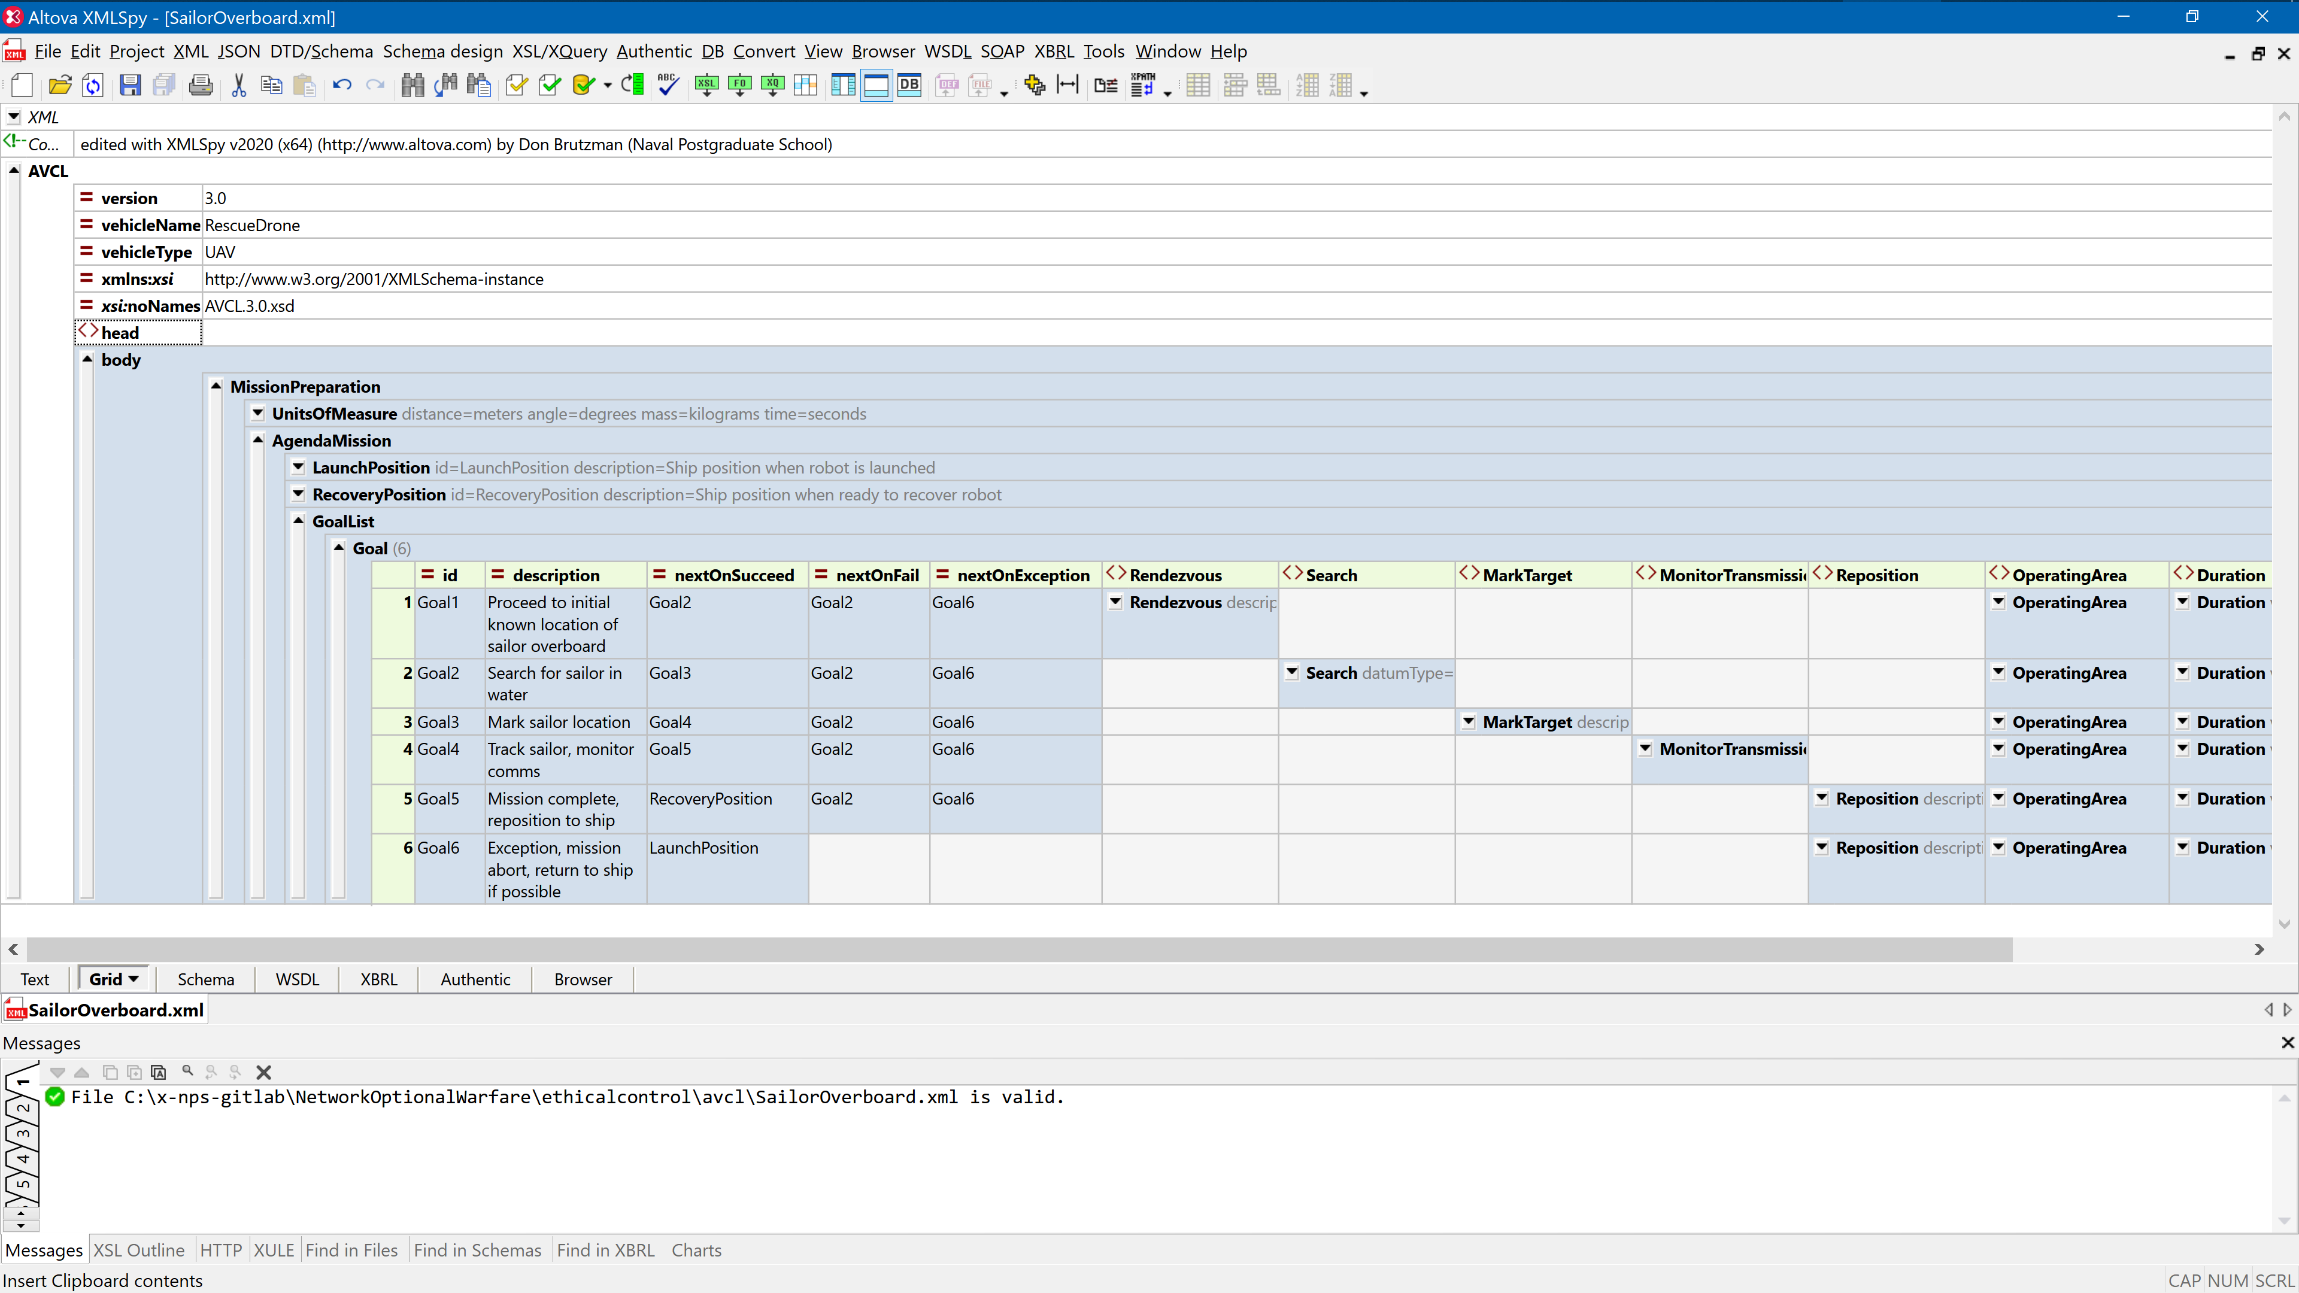
Sailor overboard mission orders AVCL

Slide 24
Ontology for Ethical Control of Unmanned Systems in a Surrogate Scenario: Example Relationship Definitions
Mission Definition Expressed in Subject-Predicate-Object Triples Using Semantic Web Standards
Excerpt of Sailor Overboard Mission, expressed in Turtle Syntax:
### https://www.nps.edu/ontologies/MissionExecutionOntology/missions#Goal_Launch
:Goal_Launch rdf:type owl:NamedIndividual ;
meo:hasNextOnFail :Goal_FailureDiagnosis ;
meo:hasNextOnSucceed :Goal_TransitSearch ;
meo:hasNextOnViolate :Goal_FailureDiagnosis .
### https://www.nps.edu/ontologies/MissionExecutionOntology/missions#Goal_TransitSearch
:Goal_TransitSearch rdf:type owl:NamedIndividual ;
meo:hasNextOnFail :Goal_SearchForSailorAdrift ;
meo:hasNextOnSucceed :Goal_TrackSailorAfloat ;
meo:hasNextOnViolate :Goal_FailureDiagnosis .

Slide 25
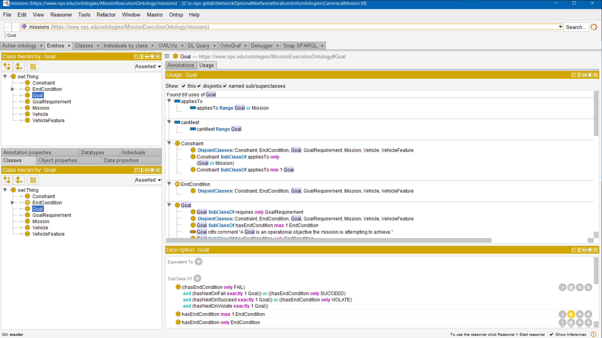
Sailor overboard mission .ttl Turtle

Slide 26
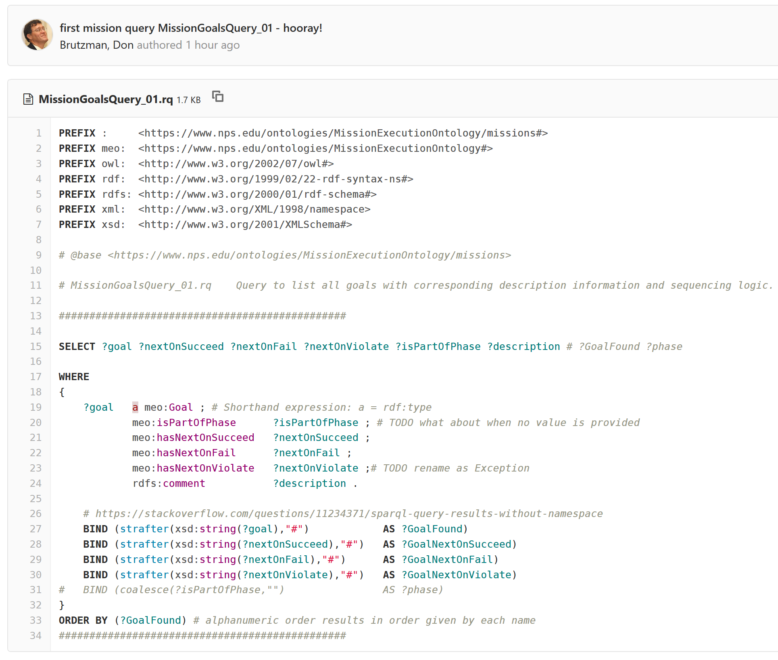
SPARQL mission query MissionQuery_01_GoalBranches.rq

Slide 27
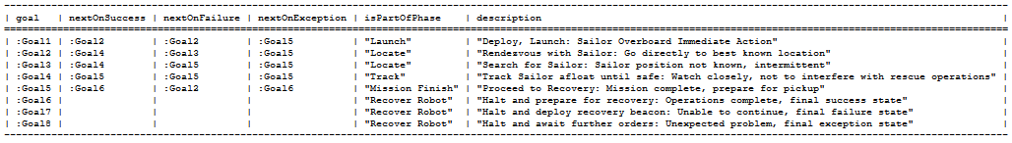
SPARQL query response SailorOverboardConverted. MissionQuery_01_GoalBranches.rq.txt
SPARQL query response
SailorOverboardConverted. MissionQuery_02_InitialGoal.rq.txt

Slide 28
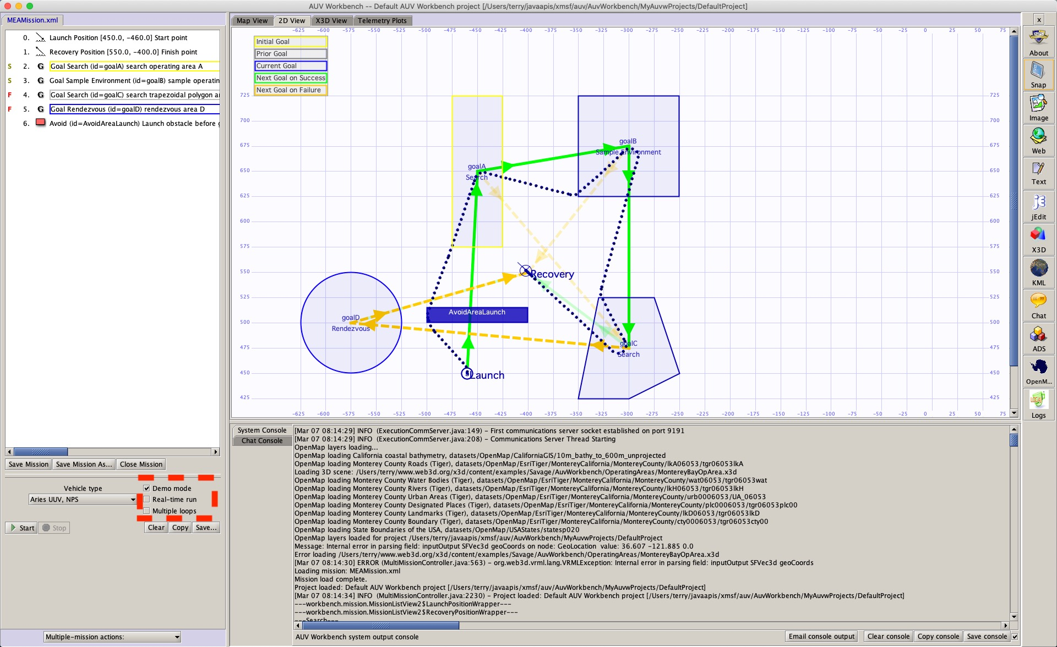
Example simulation using AUV Workbench
UPDATE IN
PROGRESS

Slide 29
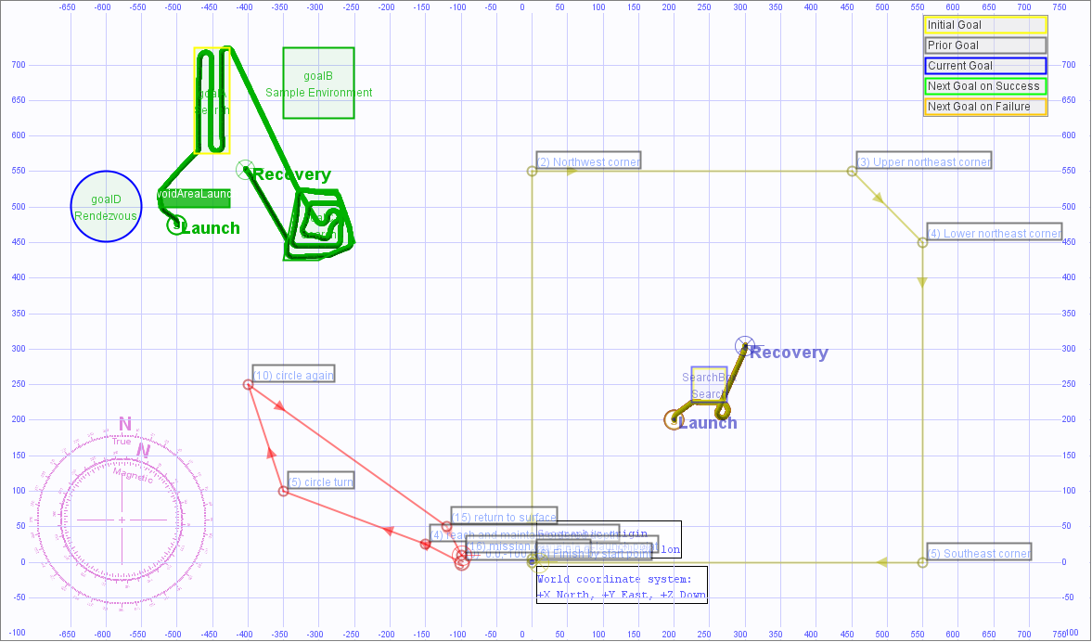
4 earlier example missions, UUV and USV

Slide 30
OODA Loops for Ethical Control Canonical Missions
Ethical Control OODA Loops | Observe | Orient | Decide | Act
Sailor Overboard | Find Sailor | Report status | Avoid interference | Track sailor until rescued or relieved
Lifeboat Rescue | Find Lifeboat | Report status | Two-way communication | Track life raft until relieved
Pirate Seizure of Merchant Ship | Find merchant ship, pirate small boats | Identity Friend Foe Neutral Unknown (IFFNU) Issue warnings | Human commander authorization to use lethal force | Attack to defend ship if provoked, stay with merchant
Hospital Ship Swarm Attack | EM threat signals detected | (no orientation step in Sense Decide Act) | Reflex-response weapons attack | Mistaken attack on friendly = war crime
Hospital Ship Defense detects spoofing anti-pattern | EM threat signals detected | IFFNU including correlation | Human requirement for lethal force unmet, attack avoided | Report threat alert, commence search for hostile actors

Slide 31
Not suitable for brute-force numerical computation
AI algorithms for Machine Learning (ML) and Data Mining are often based on statistically training against large datasets to find patterns for filters.
For example, convolutional neural networks, genetic algorithms, reinforcement learning, etc.
Often requires identifying right/wrong matches within large search spaces.
Such predictive analytics are useful for classification models using detailed and noisy sensor data. Given the central importance of IFFNU and some conditional communications to ethical control, ML filters can be helpful if carefully applied.
Nevertheless such approaches are not appropriate for carefully following Rules of Engagement (ROEs), Laws of Armed Conflict (LOAC) or other ethical prerequisites, especially when human expertise and judgement is essential for robot teams.
(Similarly, massive computation or Quantum Computing approaches might be useful in some problems, but are not of practical use for Ethical Control mission orders given by human commanders judiciously guiding remote mobile robots)
Naval history has long shown that sound human judgement is crucial for assessing best strategies and courses of action in ill-structured contexts. Semantic Web approaches are preferable and actionable for Ethical Control.

Slide 32

US Semantic Technologies Symposium (US2TS) Session: Hybrid AI for Context Understanding
10-12 MAR 2020
What is nature of context that described hybrid AI system is trying to understand?
Validate human orders to remote unmanned systems with capacity for lethal/lifesaving force.
Ethics for Rules of Engagement (ROE), Laws of Armed Conflict (LOAC), operational constraints.
What specific methods and technologies does this hybrid AI system use, and how?
Validatable XML mission syntax using controlled vocabularies with corresponding ontology.
Perform SPARQL queries of RDF/OWL to check complex relationships, requirements, violations.
Conversions for declarative orders, language implementations, Turtle triples with Protégé, ARQ.
What are current limitations in presented solution, what is plan for future work?
Representative test cases are being tested in simulation to build out verification framework.
Supports maritime operations with tractable Identification Friend Foe Neutral Unknown (IFFNU).
Expand scope with larger mission sets for diverse operations by unmanned systems in real world.
Bridge command and control (C2) with modeling and simulation (M&S) virtual environments, for
Domain-expert qualification of hardware/software systems using tactical scenarios as unit tests.

Slide 33


IEEE P7000-series Standards Projects https://ethicsinaction.ieee.org
P7000 Model Process for Addressing Ethical Concerns during System Design
P7001 Transparency of Autonomous Systems
P7002 Data Privacy Process
P7003 Algorithmic Bias Considerations
P7004 Standard on Child and Student Data Governance
P7005 Standard on Employee Data Governance
P7006 Standard on Personal Data AI Agent Working Group
P7007 Ontological Standard for Ethically driven Robotics and Automation Systems
P7008 Standard for Ethically Driven Nudging for Robotic, Intelligent and Autonomous Systems
P7009 Standard for Fail-Safe Design of Autonomous, Semi-Autonomous Systems
P7010 Well-being metrics Standard for Ethical Artificial Intelligence and Autonomous Systems
P7011 Stadard for the Porcess of Identifying and Rating the Trustworthiness of News Sources
P7012 Standard for Machine Readable Personal Privacy Terms
P7014 Standard for Ethical Considerations in Emulated Empathy in Autonomous and Intelligent Systems

Slide 34

IEEE Standards Project P7007 for Ontological Standard for Ethically driven Robotics and Automation Systems
IEEE Global Initiative on Ethics of Autonomous and Intelligent Systems.
https://ethicsinaction.ieee.org includes large document providing broad rationale.
Includes 15 separate working groups in IEEE Standards Association (IEEE-SA).
Relevant group: P7007, Ethically driven Robotics and Automation Systems.
“IEEE P7007 Standards Project for Ontological Standard for Ethically driven Robotics and Automation Systems establishes a set of ontologies with different abstraction levels that contain concepts, definitions and axioms that are necessary to establish ethically driven methodologies for the design of Robots and Automation Systems.”
http://standards.ieee.org/develop/project/7007.html
Must be IEEE member, observe patent-policy requirements to participate in working group.
“Not the intent to specify required ethical behaviors, but rather to formalize a vocabulary of terms, concepts, and relationships that can be used to enable unambiguous discussion among […] communities regarding what it means for autonomous systems to exhibit ethical behaviors.”
Excellent forum with rich references, worth observation and participation.
Active work: align several Ethical Control terms, concepts, use cases with P7007.

Slide 35
Unmanned Maritime Autonomy Architecture (UMAA)
Richard R. Burgess, “Navy Requests Information for Unmanned Maritime Autonomy Architecture,” SEA POWER, 20 FEB 19
“The intent of UMAA is to provide overarching standards that various UUVs and USVs can be built to in order to avoid creating multiple conflicting systems in the future”
“The UMAA is being established to enable autonomy commonality and reduce acquisition costs across both surface and undersea unmanned vehicles.”
Topics of interest include Situational Awareness, Sensor and Effector Management, Processing Management, Communications Management, Vehicle Maneuver Management, Vehicle Engineering Management, Vehicle Computing Management, Support Operations
Multiple public NAVSEA documents refer to autonomy efforts and UMAA.
NAVSEA PMS 406 is Program Office for Unmanned Maritime Systems
NAVSEA Fact Sheet: Unmanned Maritime Systems Program Office (PMS 406) https://www.navsea.navy.mil/Portals/103/Documents/Exhibits/SNA2019/UnmannedMaritimeSys-Small.pdf
Automated Management of Maritime Navigation Safety Navy SBIR 2020.1 - Topic N201-059, https://www.navysbir.com/n20_1/N201-059.htm
Proposed Critical Path Forward

Slide 36

Acting SECNAV Modly: unmanned, data, wargame, iterate
SECNAV Modly: Path to 355 Ships Will Rely on New Classes of Warships
USNI News, Megan Eckstein, 3 February 2020
“You look at the frigate program: we think, because of the way we’ve approached that program, we’ve probably taken three years off the product development lifecycle for that. So we have to start doing the same type of thing: looking at proven hulls, things that can be adaptable for different areas. I understand the Hill’s concerns about unmanned, and we get that. … We have to convince them with data: we have to wargame this, we have to iterate it over and over again.”
Honorable Thomas Modly, Acting SECNAV
Notes:
[Emphasis added]. Force structure debates typically occur each spring.

Slide 37
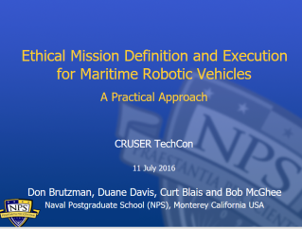
Key Insights regarding Human Ethical Control
Humans in military units are able to deal with moral challenges without ethical quandaries,
by using formally qualified experience, and by following mission orders that comply with Rules of Engagement (ROE) and Laws of Armed Conflict (LOAC).
Ethical behaviors don’t define the mission plan. Instead, ethical constraints inform the mission plan.
Naval forces can only command mission orders that are
Understandable by (legally culpable) humans, then
Reliably and safely executed by robots.
Reference: CRUSER TechCon Overview 2016
https://gitlab.nps.edu/Savage/EthicalControl/tree/master/documents/presentations
Notes:
Laws of Armed Conflict (LOAC) are also referred to as International Humanitarian Law (IHL).

Slide 38
Assessment of Current Thinking
Human supervision of potentially lethal autonomous systems is a matter of serious global importance.
Wide consensus is emerging on principles, aspects of the problem, elements of solutions, and need to achieve better capabilities.
Much philosophical concern but few concrete activities are evident.
Ethical Control of Unmanned Systems project appears to provide a needed path towards practice, with the historic role of warfighting professionals more central than ever as weapons autonomy grows.

Slide 39
Conclusions
Human supervision is required for any unmanned systems holding potential for lethal force.
Cannot push “big red shiny AI button” and hope for best – immoral, unlawful.
Similar imperatives exist for supervising systems holding life-saving potential.
Human control of unmanned systems is possible at long ranges of time-duration and distance through well-defined mission orders.
Readable and sharable by both humans and unmanned systems.
Validatable syntax and semantics through understandable logical constraints.
Testable and confirmable using simulation, visualization, perhaps qualification.
Coherent human-system team approach is feasible and repeatable.
Semantic Web confirmation can ensure orders are comprehensive, consistent.
Human role remains essential for life-saving and potentially lethal scenarios.

Slide 40
Contact
Don Brutzman
brutzman@nps.edu
http://faculty.nps.edu/brutzman
Code USW/Br, Naval Postgraduate School
Monterey California 93943-5000 USA
1.831.656.2149 work
1.831.402.4809 cell
Notes:
Questions and feedback are always welcome. Thanks for considering the possibilities.

Slide 41
Contact
Curt Blais
clblais@nps.edu
home page
Code MV/Bl, Naval Postgraduate School
Monterey California 93943-5000 USA
1.831.656.3215 work
Notes:
Questions and feedback are always welcome. Thanks for considering the possibilities.

Slide 42
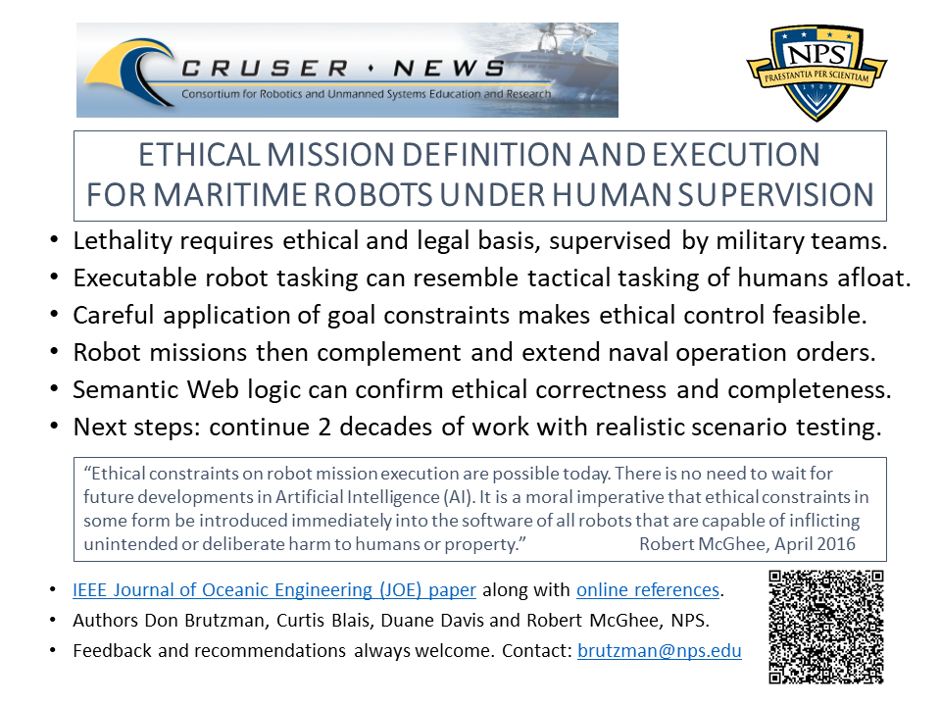
Ethical Control flyer

